Slide 1


Software & Hardware Migration
for Analog & Digital I/O
in Rydberg-Assisted
Quantum Engineering of Light Experiment
Ningshun CHEN
Supervised By
Alexei OURJOUMTSEV & Sébastien GARCIA

Slide 2


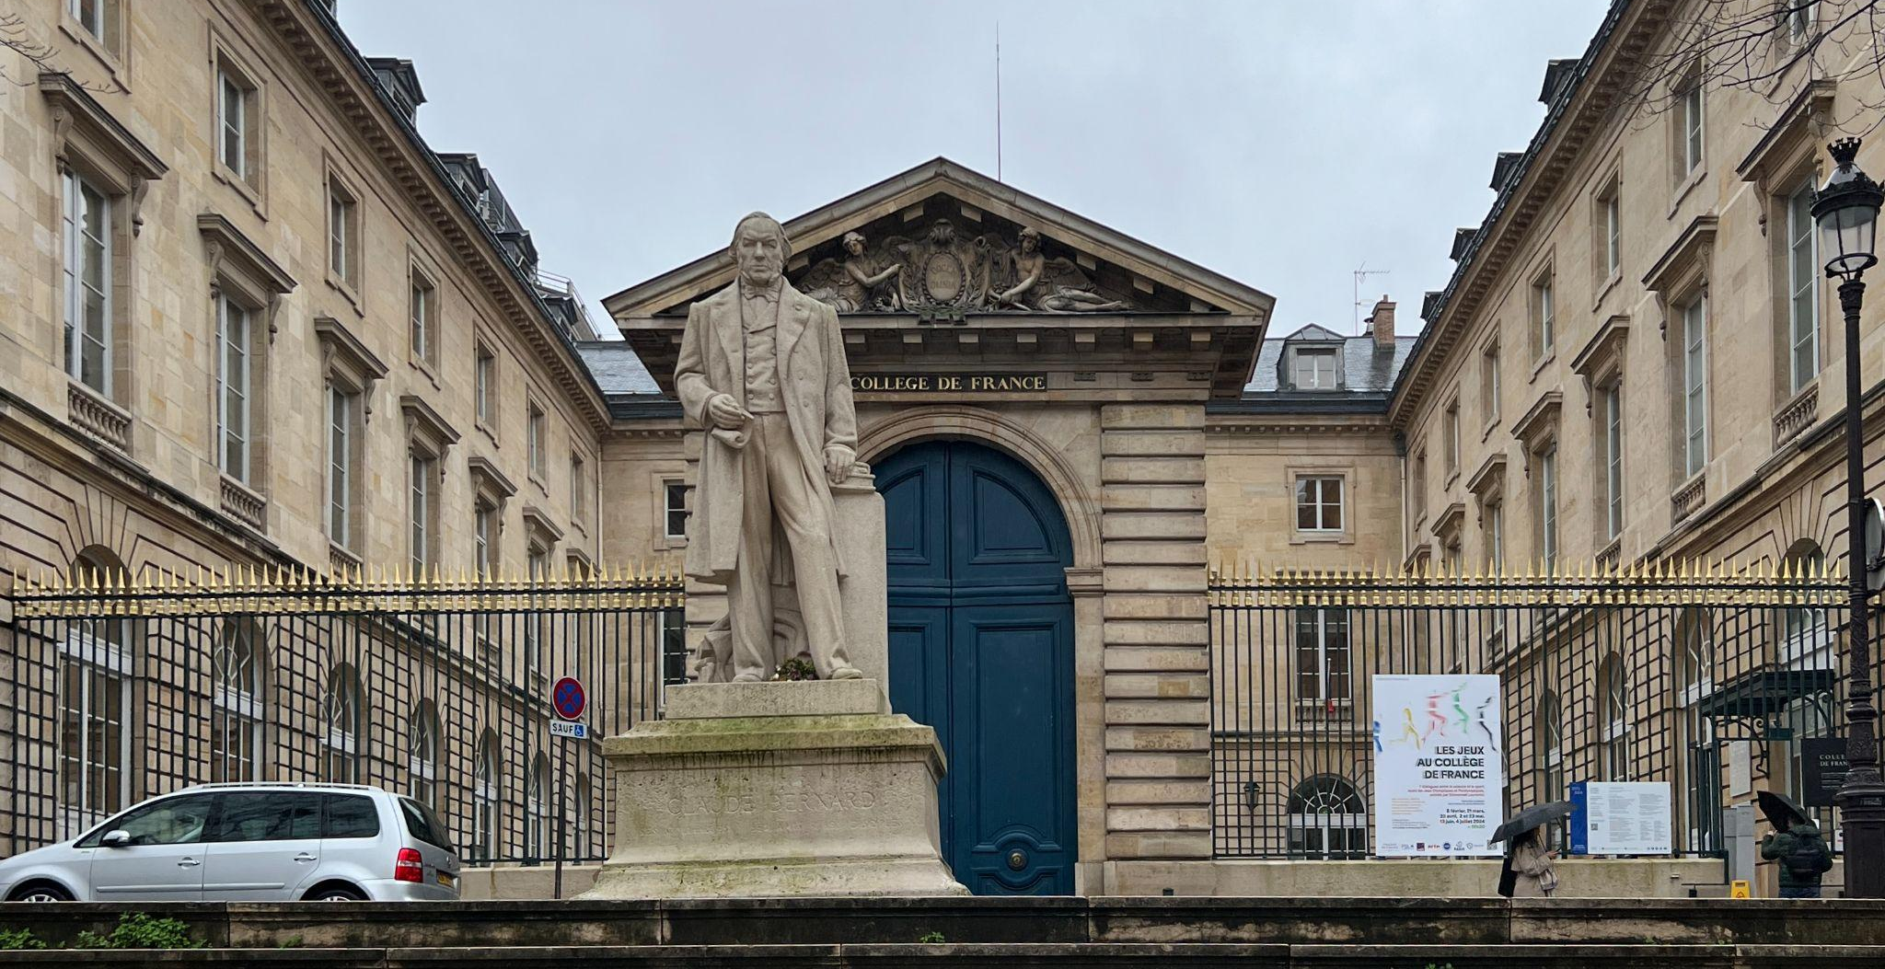
Quantum Photonics group
One principal investigator
One CNRS researcher
Two Doctoral students
Two Master 2 interns
One Master 1 intern

Slide 3
The Experiment

Slide 4
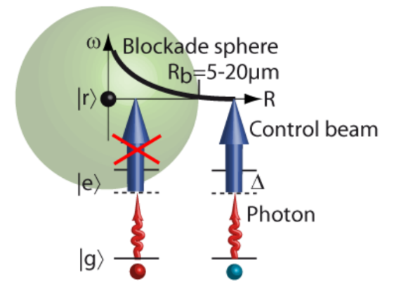
Theoretical Background
Interactions b/w photons
Rb atoms & Rydberg states
Optical cavity
Advantages
Better photon control
Minimize information loss
Experimental repeatability
Probe & control beams

Slide 5
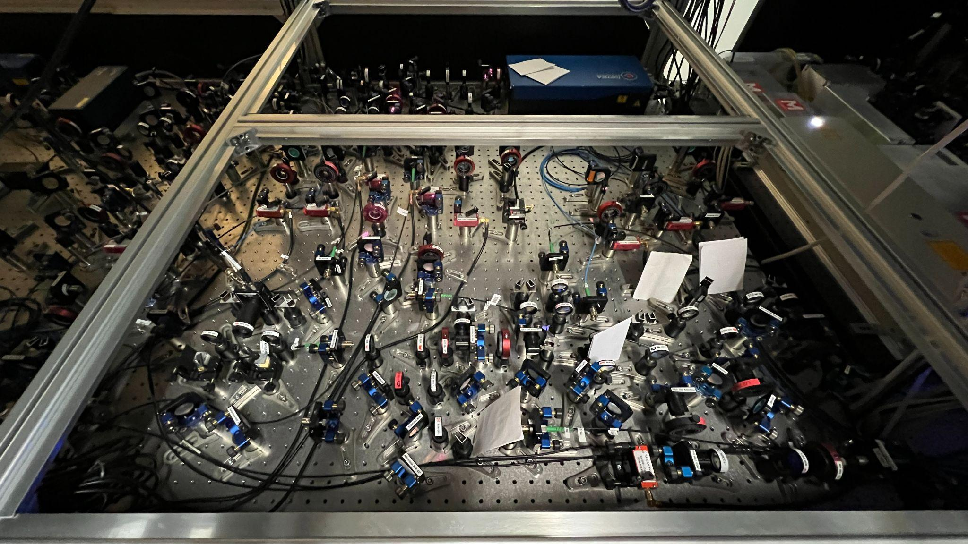
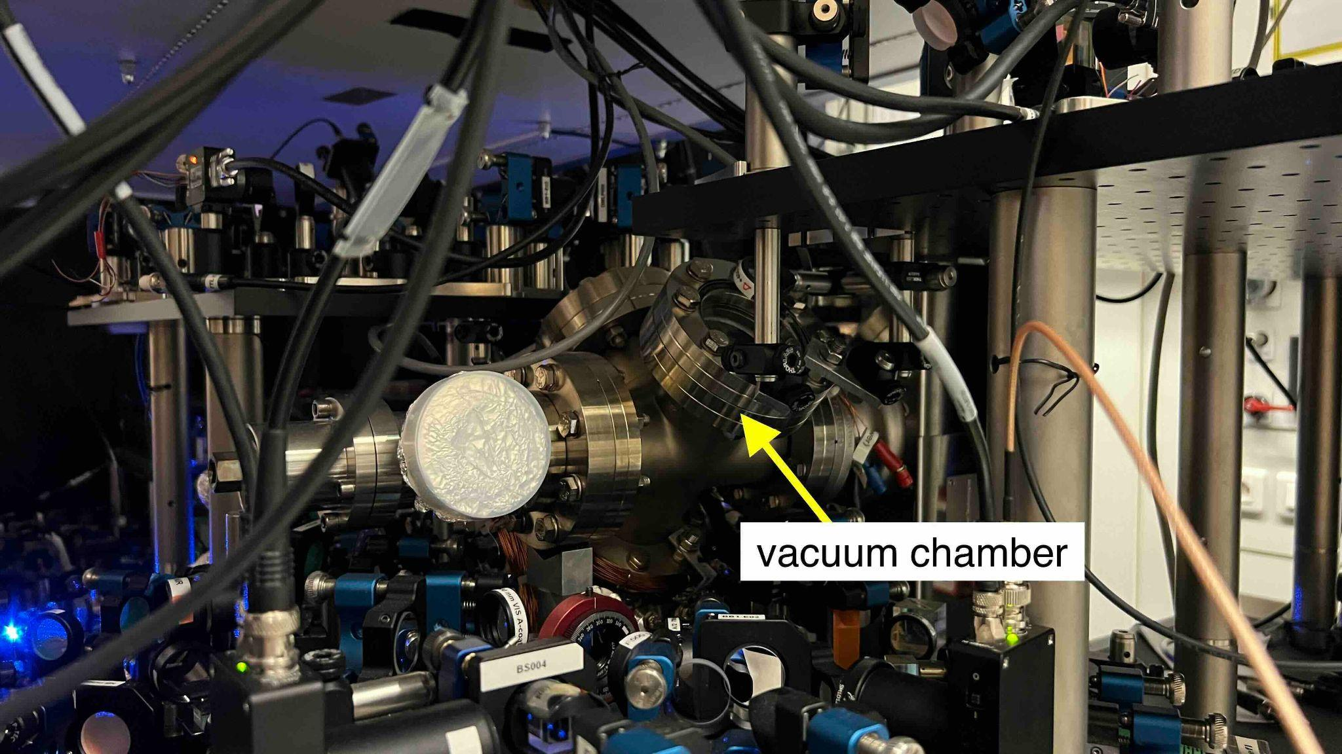
Experimental Setup
Controls & prepares lasers
Hosts the optical cavity

Slide 6
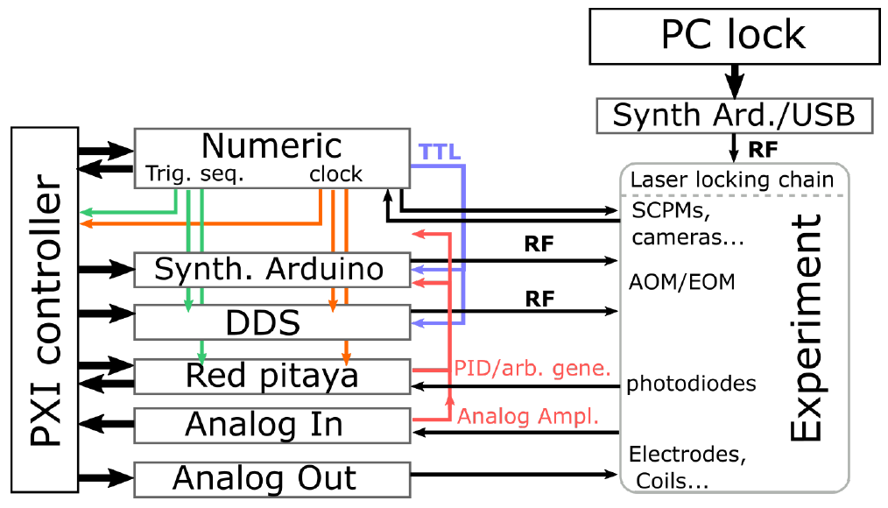
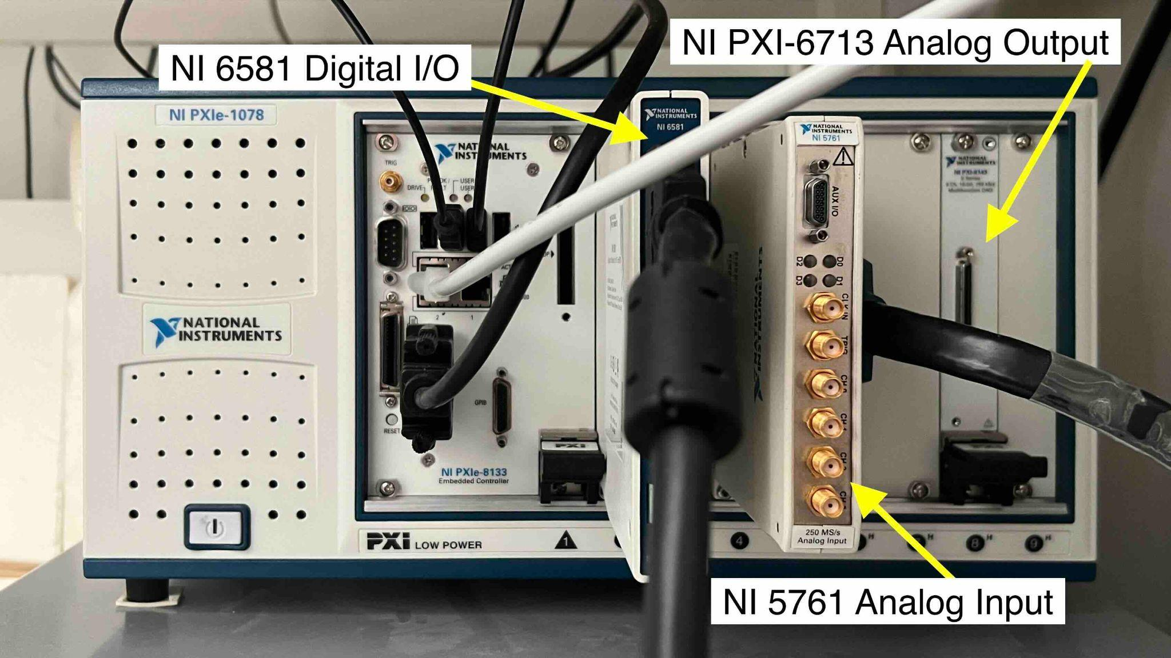
Hardware
Experimental control system
NI PXIe-1078 chassis

Slide 7
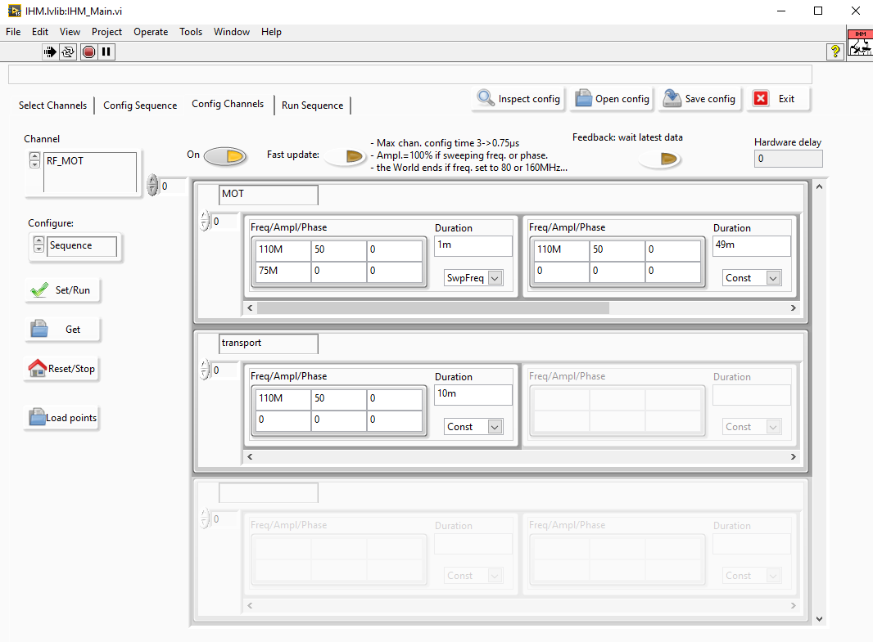
Software
VITO
Main control of the platform
Home-made LabVIEW program

Slide 8

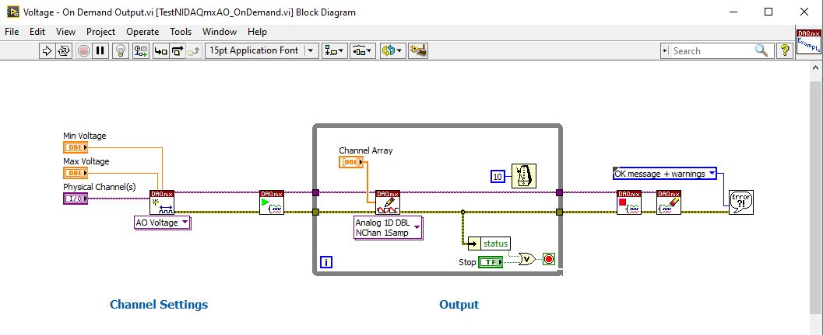
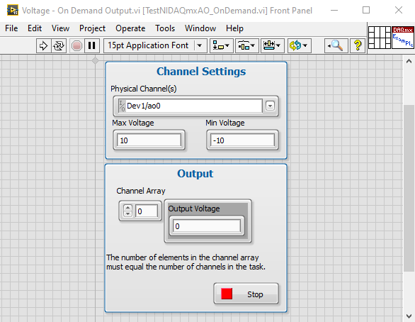
Laboratory Virtual Instrument Engineering Workbench — 2015
Design platform & development environment
Block Diagram
Front Panel

Slide 9
Subscription starting in 2022
Migration to open source alternatives
Cost reduction
Development efficiency
Experimental adaptability
3 Modules of interest
NI PXIe-1078 chassis

Slide 10
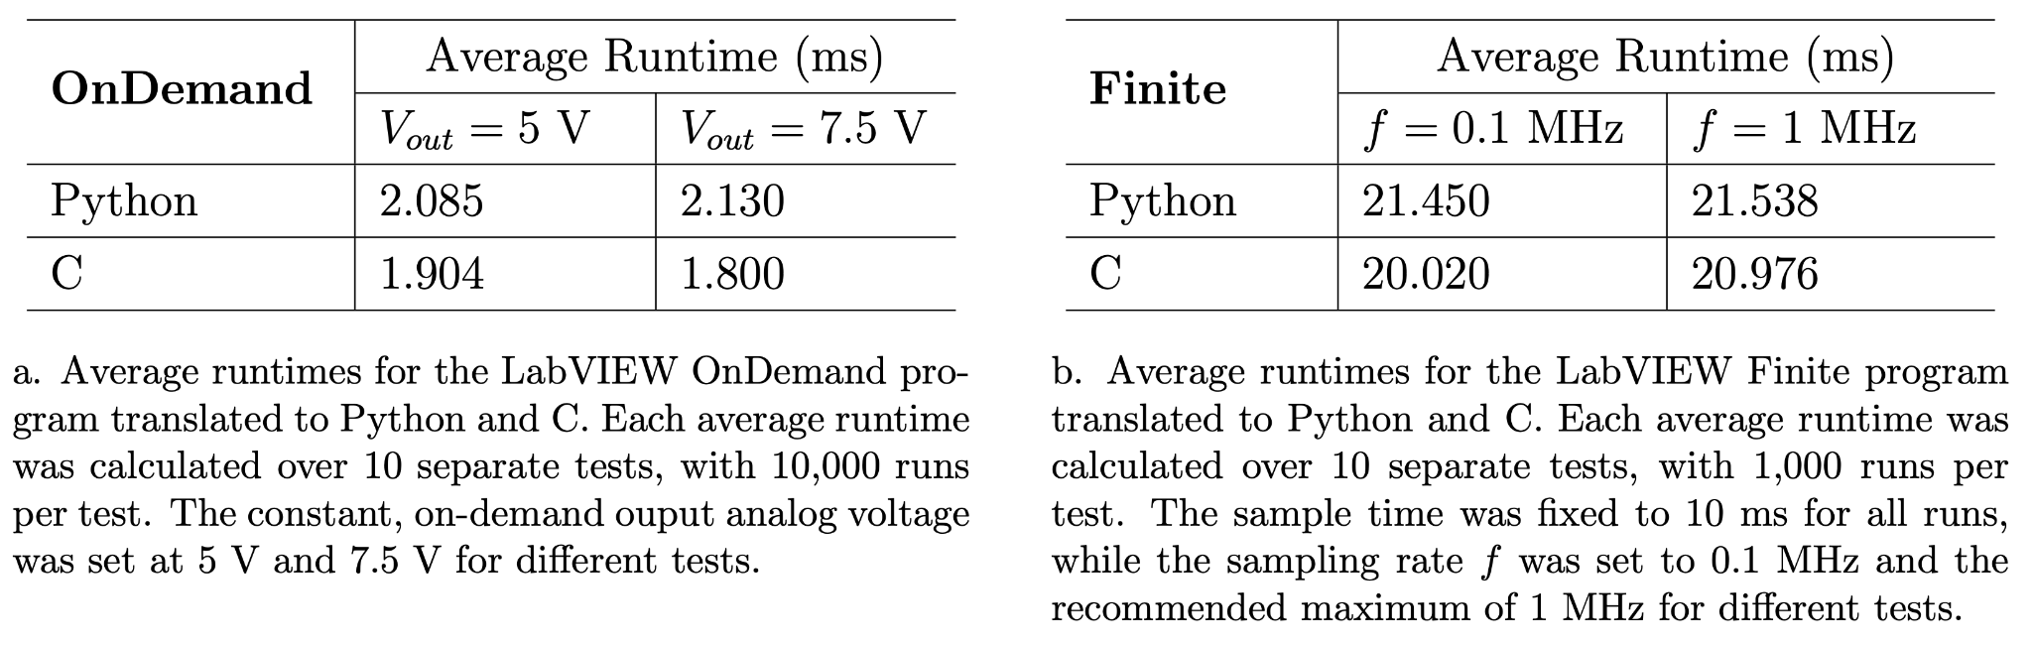
NI PXI-6713 Analog Output
NI-DAQmx instrument driver
Translation from LabVIEW to Python & C
OnDemand, Finite
Runtime tests :

Slide 11
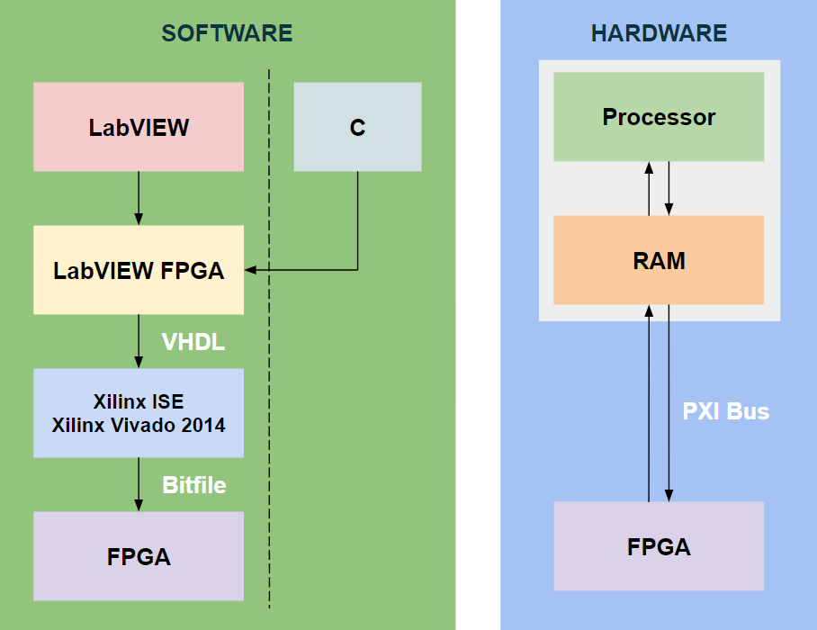
NI 6581 Digital I/O & NI 5761 Analog Input
“Smart” modules with FPGAs
Proprietary bottleneck
Replace modules completely

Slide 12
Replacing NI FPGA Modules

Slide 13
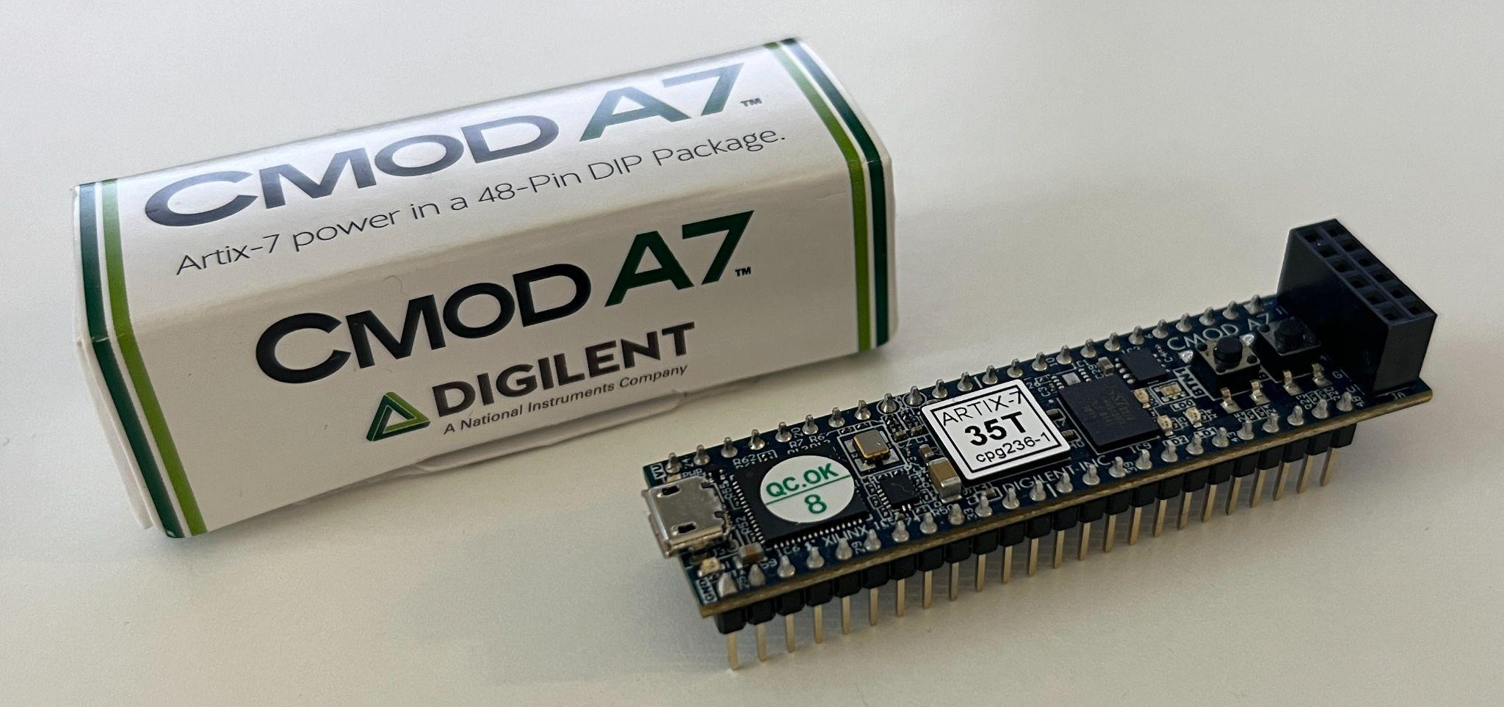
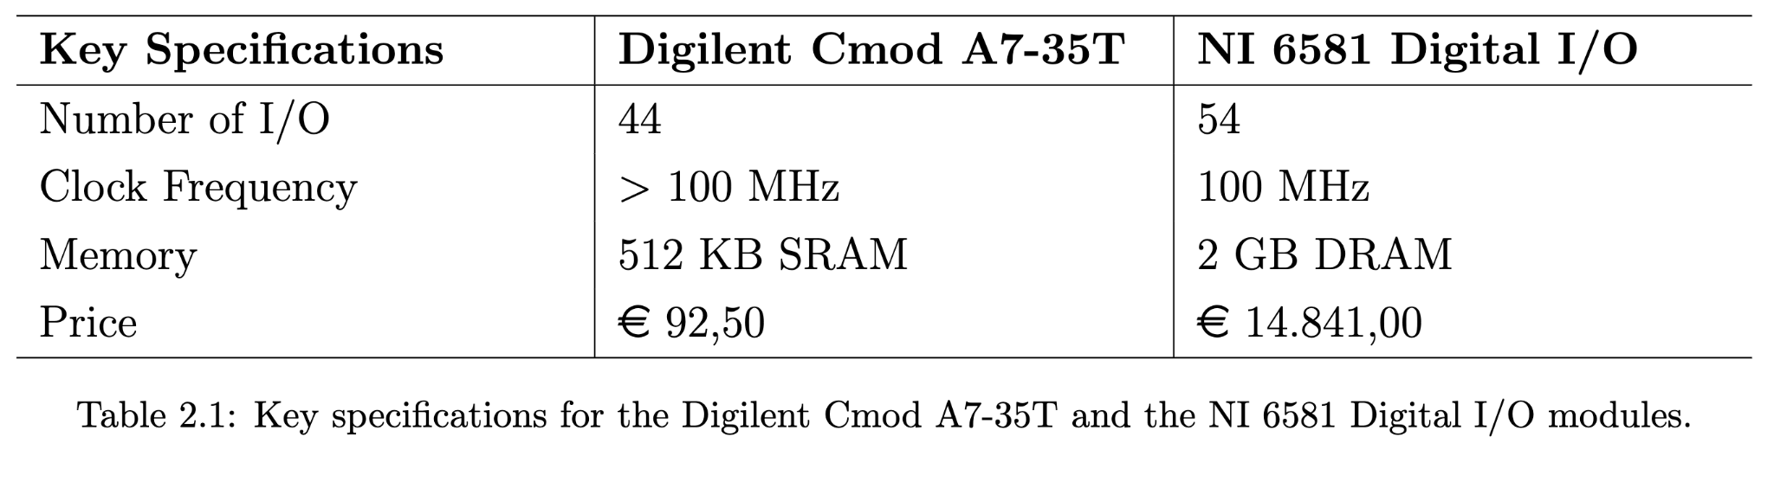
Digilent Cmod A7-35T as Digital I/O
48 pins built around Xilinx Artix 7 FPGA
clock source, SRAM, basic I/O, etc
Already used for some experimental control
Can functionally replace a fraction of digital I/O
More effort is needed
Intro to FPGAs & HDLs

Slide 14
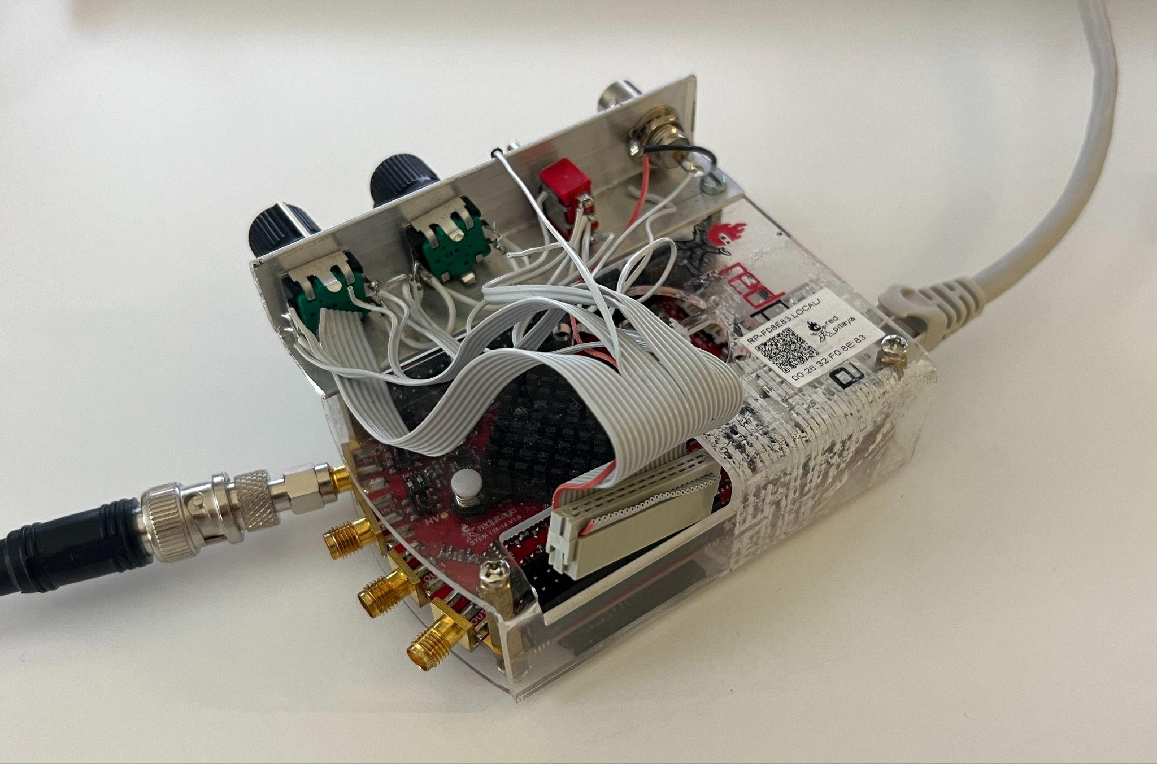
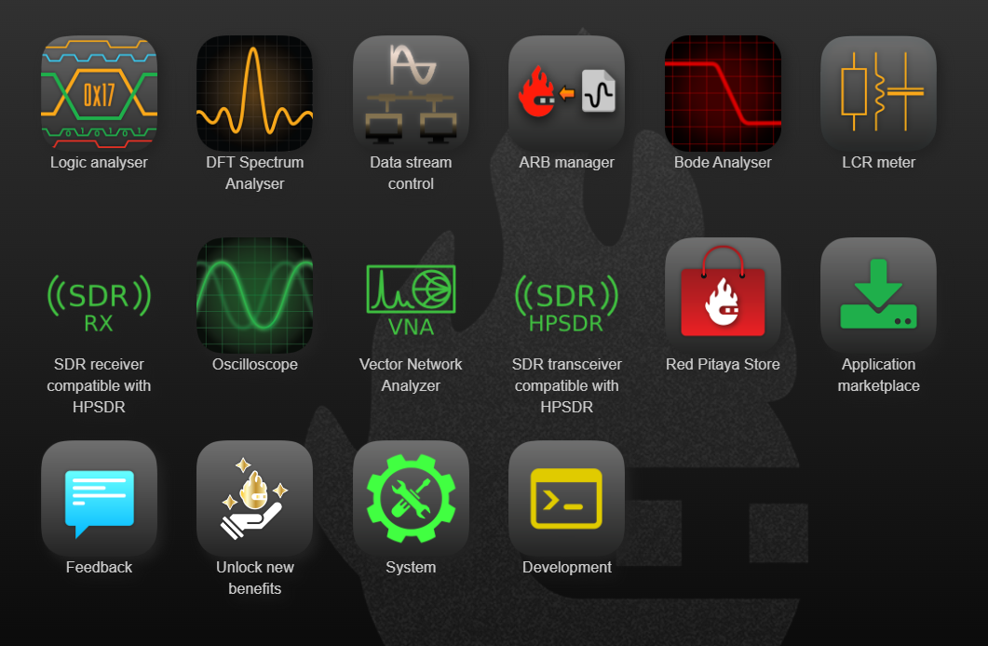
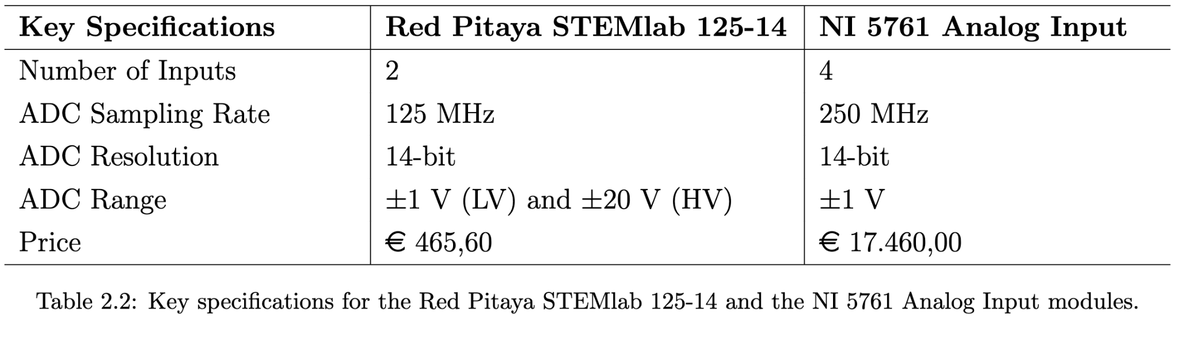
Red Pitaya STEMlab 125-14 as Analog Input
Single-board computer
Xilinx SoC (CPU, FPGA)
125 MS/s I/O
14-bit ADC & DAC
ethernet, etc
Default applications
Alternative for lab equipments
Data acquisition device
Sufficient memory
Noise limits
Discontinuous acquisition

Slide 15
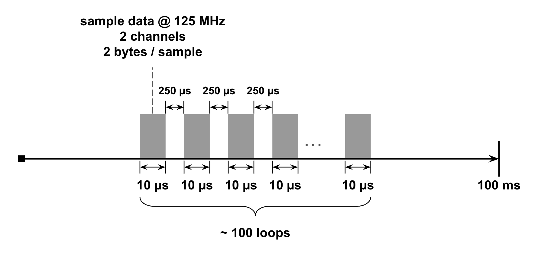
Experimental Data Acquisition
NI 5761 Analog Input
4 channels · 250 MHz · 2 bytes/Sample · 10 μs/loop · 100 loops = 2 MB
Red Pitaya
2 channels · 120 MHz · 2 bytes/Sample · 10 μs/loop · 100 loops = 0.5 MB
Repeat every 130 ms

Slide 16
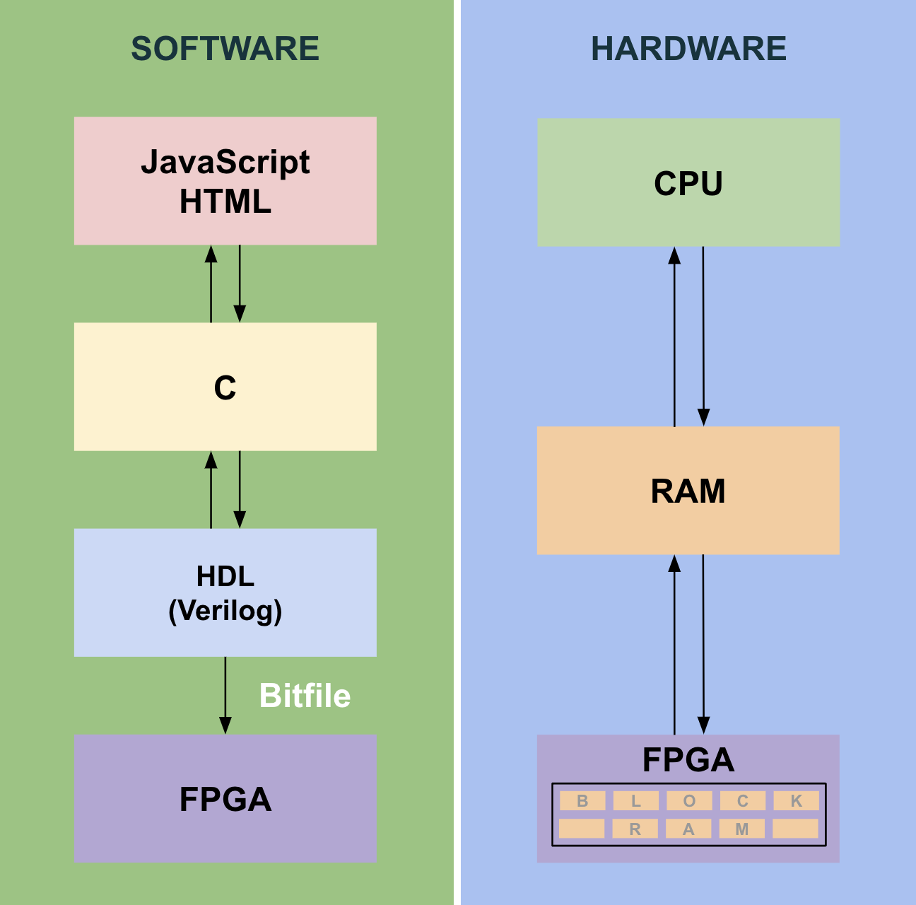
Red Pitaya: Input Data Memory Storage & Extension
512 MB on-board RAM
Methods
Lock-in+PID with Oscilloscope
Data Streaming
Deep Memory Acquisition (DMA)

Slide 17
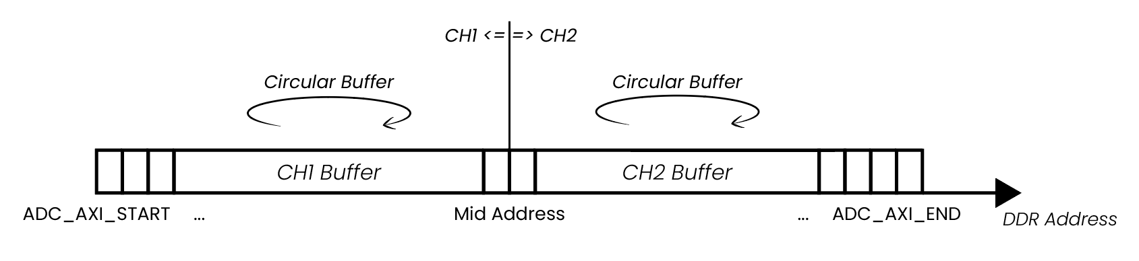
Deep Memory Acquisition (DMA)
Variable ADC buffer RAM
Default : 2 MB
Max recommended : 412 MB
125 MS/s @ 32-bit resolution
RAM reconfiguration & rebuild
2 MB → 4 MB
Remote ~ SCPI (Python / MATLAB)
On-board ~ API (Python / C)
Successful test acquisitions

Slide 18
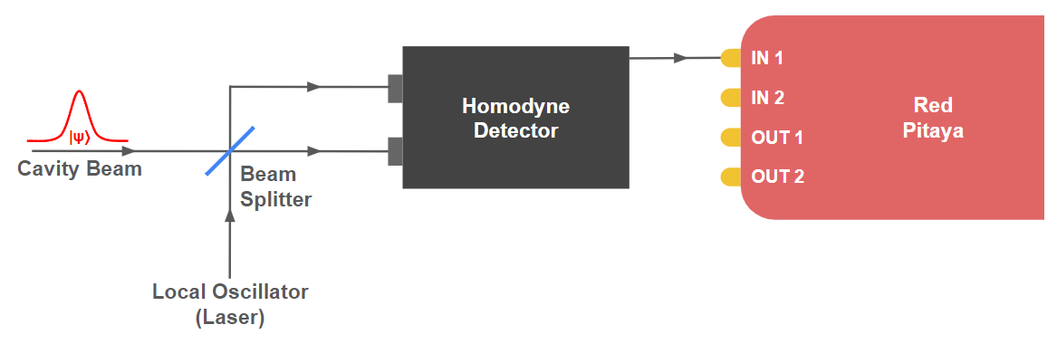
Homodyne Detection System with Red Pitaya

Slide 19
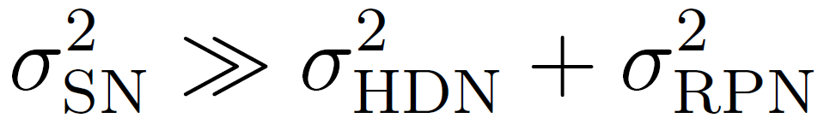
Homodyne Detection System with Red Pitaya
Noise

Slide 20
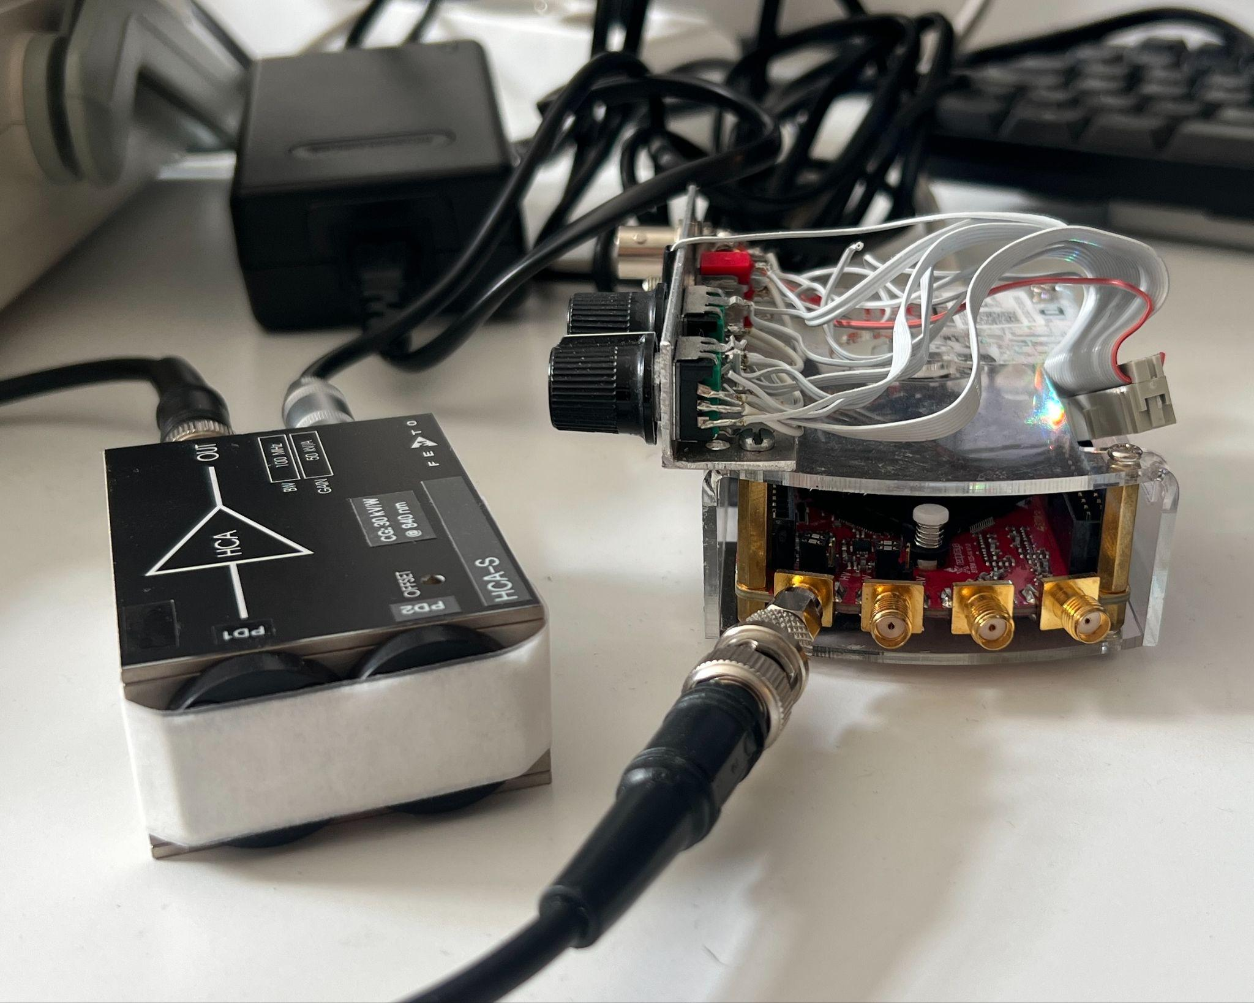
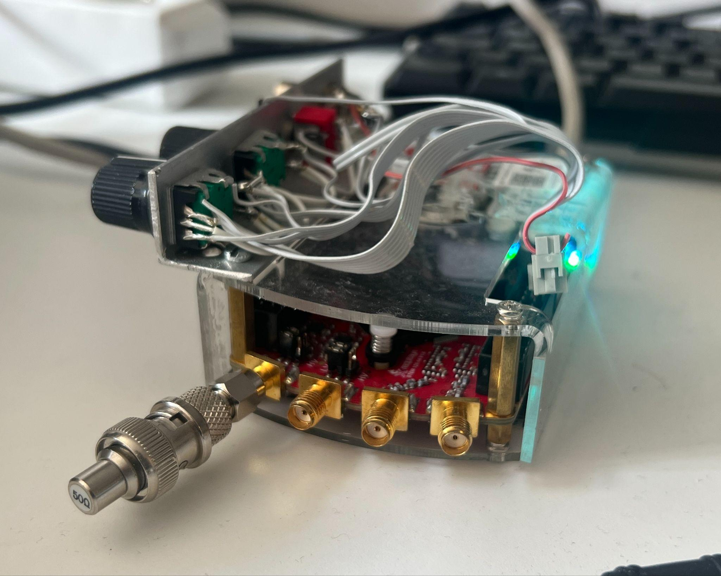
Homodyne Detection System with Red Pitaya
Electronic Noise
homodyne
detector
50 Ω resistor

Slide 21
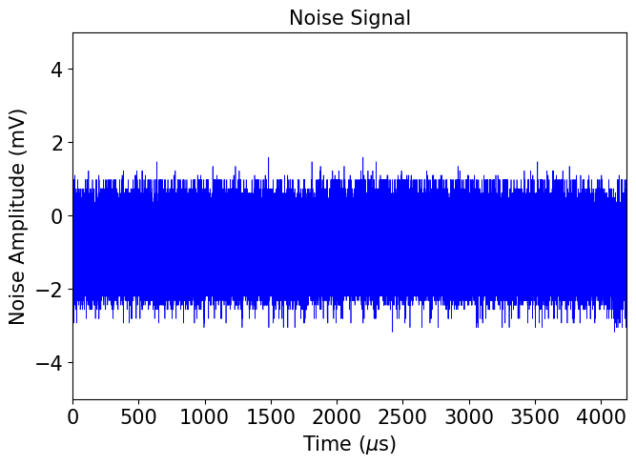
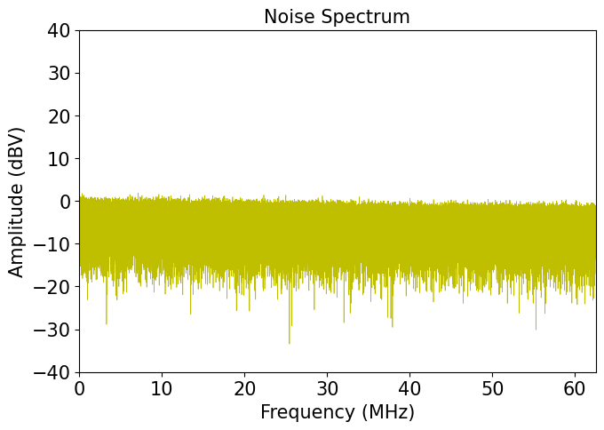
Red Pitaya: Intrinsic Electronic Noise
N = 524,288

Slide 22
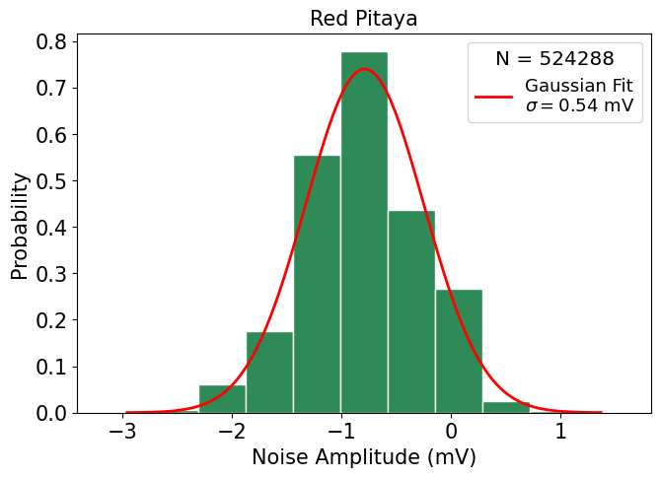
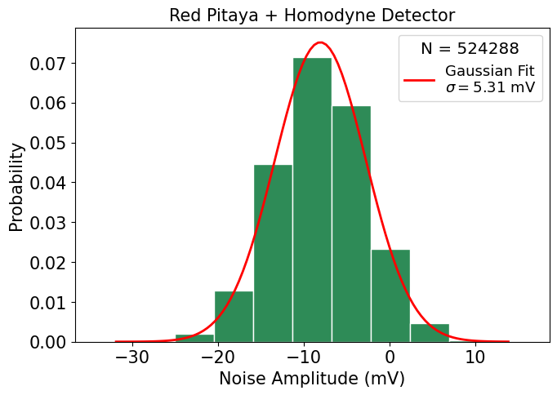
Homodyne Detection System
Electronic Noise
σ_{HDN}² + σ_{RPN}² = (5.31 mV)²
σ_{HDN} = 27.88 (mV)² >> σ_{RPN}² = 0.29 (mV)²

Slide 23
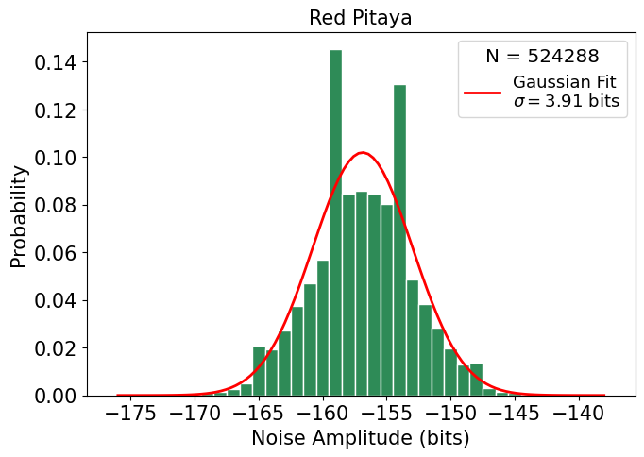
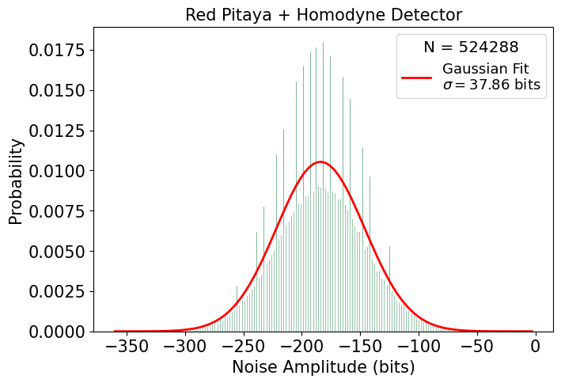
Homodyne Detection System
Electronic Noise: Bits

Slide 24
Conclusion
Analog output w. Python / C
Digital I/O w. Digilent Cmod A7-35T
Analog input w. Red Pitaya
Noise distribution (bitwise resolution)
Discontinuous acquisition

Slide 25
Annex

Slide 26
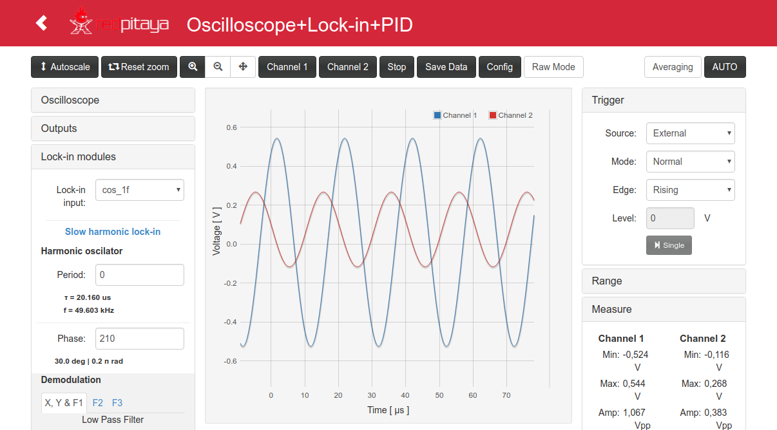
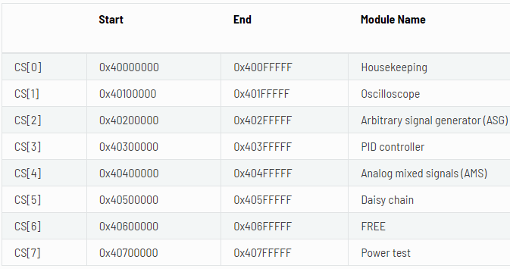
Lock-in+PID with Oscilloscope Application
Maintains intensity of probe beam
1 IP core dedicated
16⁵ bytes ~ 1 MB
Channel A: 0x40110000
Channel B: 0x40120000

Slide 27
Methodology
Hardware modification
4-byte single-channel → dual-channel storage
4-byte → 2-byte per sample
16,384 → 131,072 samples
Per channel (8x more samples)
0x4012FFFF → 0x4018FFFF
16⁴ → 8 * 16⁴ bytes
65 KB → 0.25 MB !!!
Software modification

Slide 28
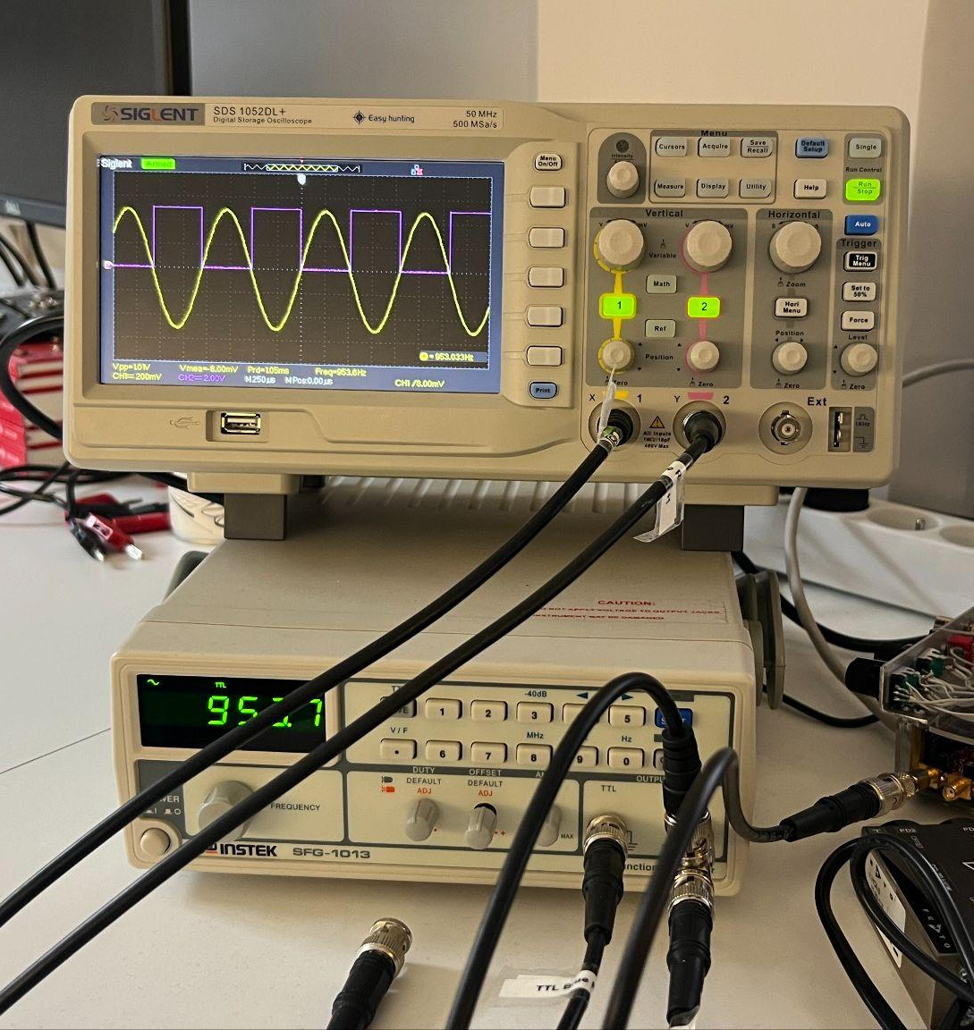
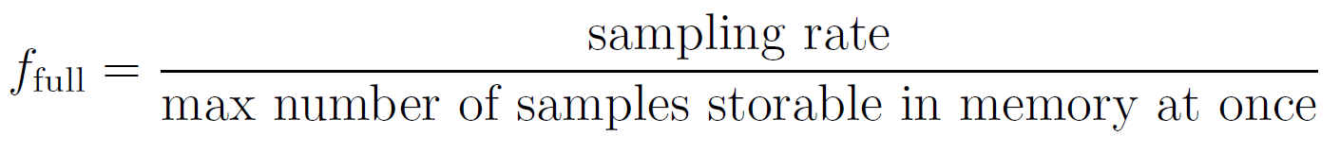
Tests
RAM monitor
Sampling one waveform
Original
f_{full} = 7629 Hz, T_{full} = 131 μs
Extended
f_{full} = 954 Hz, T_{full} = 1049 μs

Slide 29
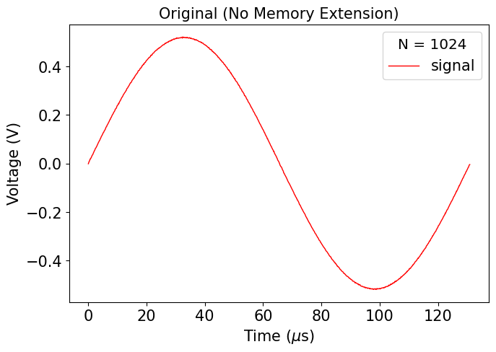
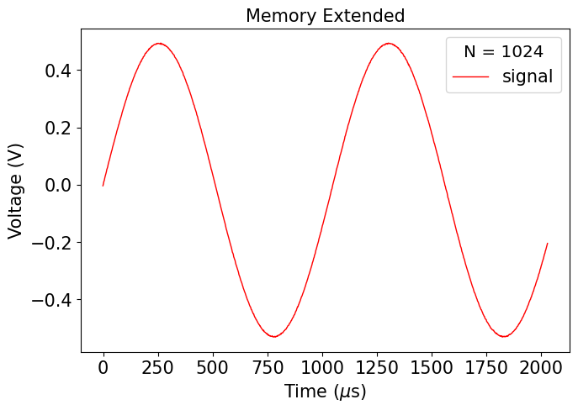
Results
f_{full} = 7629 Hz, T_{full} = 131 μs
f_{full} = 954 Hz, T_{full} = 1049 μs

Slide 30
Conclusion
Buggy waveform behavior
Front-end decimation
Not practical for DAQ
Lock-in+PID with Oscilloscope Application

Slide 31
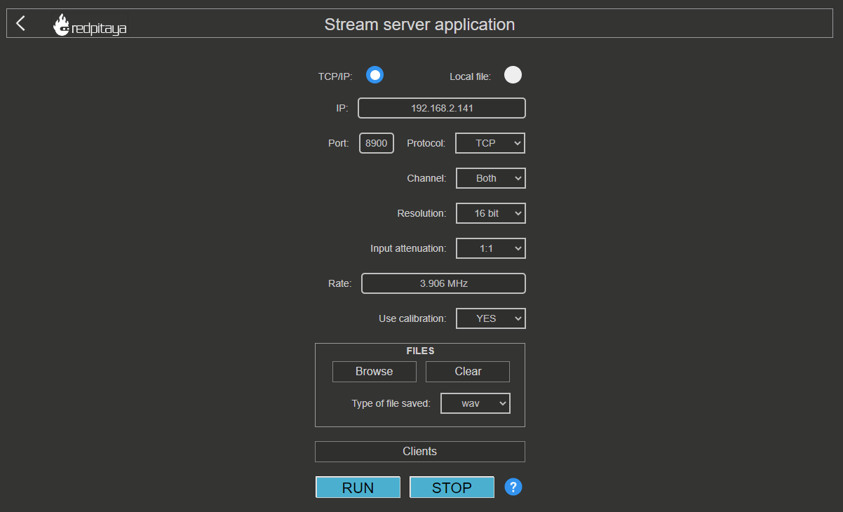
Data Streaming Application

Slide 32
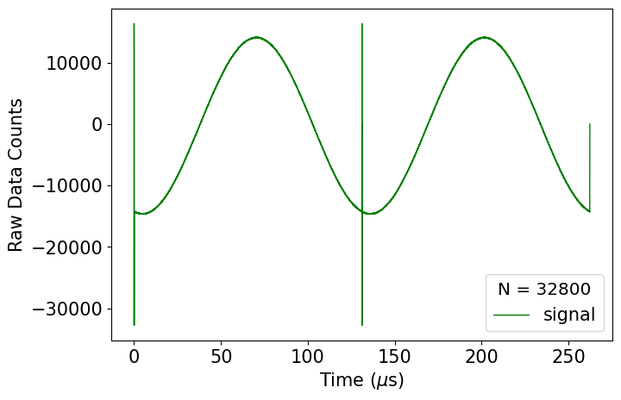
Tests & Results
Assumption for default allocation
16⁴ bytes = 65 KB = 32,768 samples (16 bits / sample)
f_{full} = 3815 Hz
125 MS/s

Slide 33
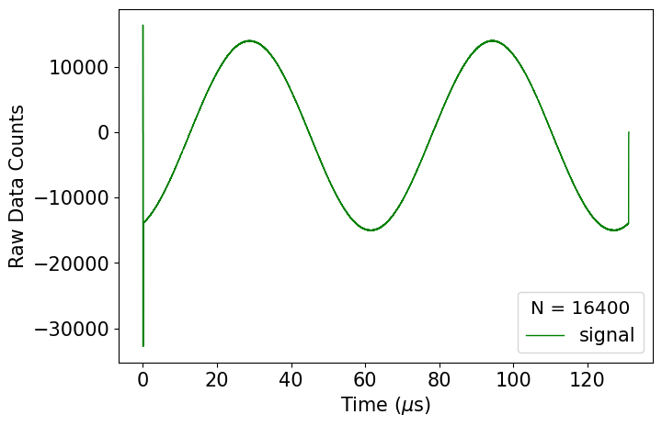
Tests & Results
Assumption vs. verification
16⁴ bytes = 65 KB = 32,768 samples → 16⁴/2 bytes = 32 KB = 16,400 samples
f_{full} = 3815 Hz → f_{full} = 7629 Hz
125 MS/s → 62.5 MS/s

Slide 34
Conclusion
Sampling rate field is buggy
Issues remain in newest ecosystem
Also not a practical for DAQ
Data Streaming Application

Slide 35
DMA Code Structure
Configure signal units, decimation, and trigger source and level
Get reserved memory region address and size
Set DMA buffer address and size for each input channel
Continuously acquire data until buffer is full
Read data from buffer
Process and save data to external file

Slide 36
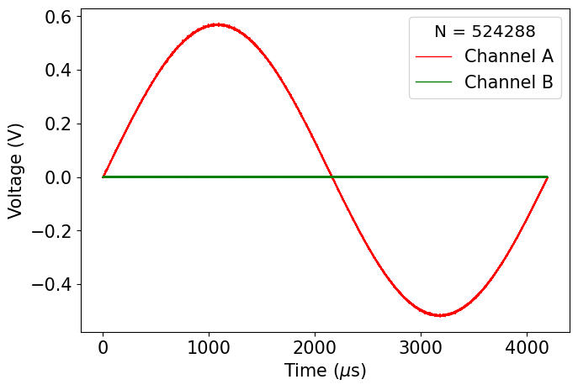
DMA Tests & Results
2 MB / channel
f_{full} = 238 Hz

